Slide 1
Election 2016 Analysis
Shivam SWARNKAR

Slide 2
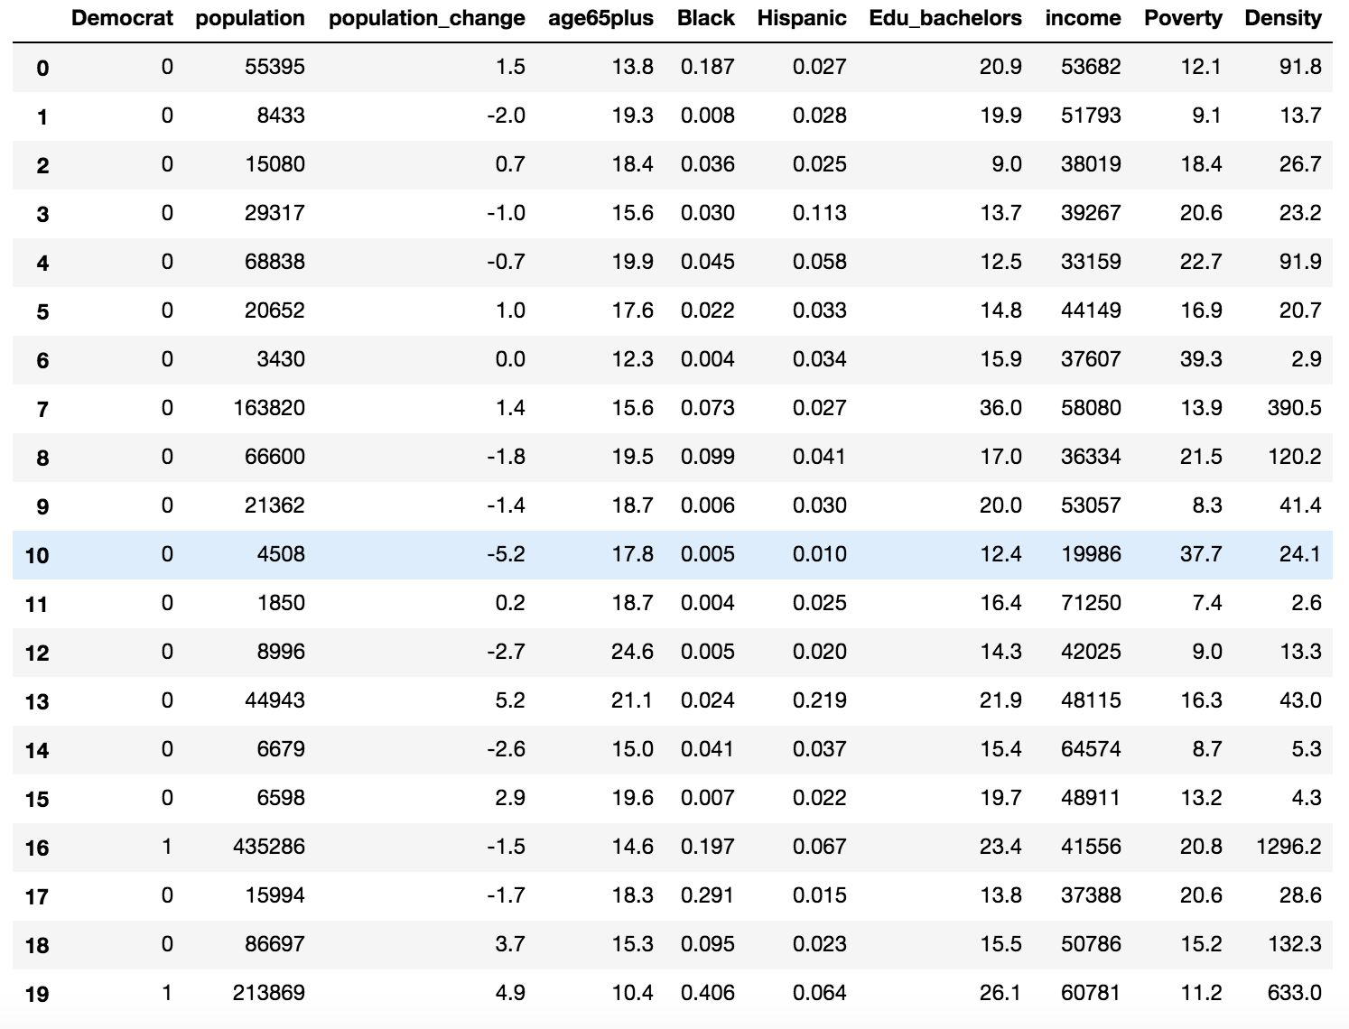

Slide 3
Objective
Train, Predict and Analyze data using Logistic regression and Neural Network models
How accurate could Logistic regression predict?
How accurate could NN model predict?
Which one was better, why?
Which features affect the output the most?
Which features don’t affect the output?
How can this model be improved?
Any special findings of behaviors or patterns in dataset?

Slide 4
Approach & Findings
Trained models with 2335 samples and tested with 778 samples
Neural Network : 9-4-1 Architecture with BP : Accuracy 93.43%
Logistic Regression : sklearn linear_model : Accuracy 91.19%
Correlation matrix, weight matrix & all subset regression for pattern analysis
Notes:
Cross entropy +

Slide 5
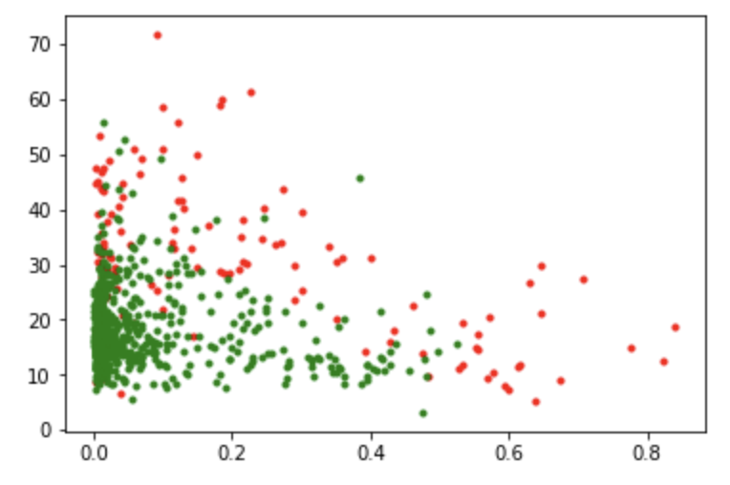
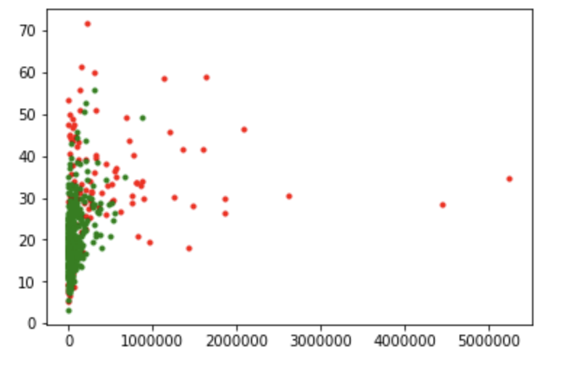
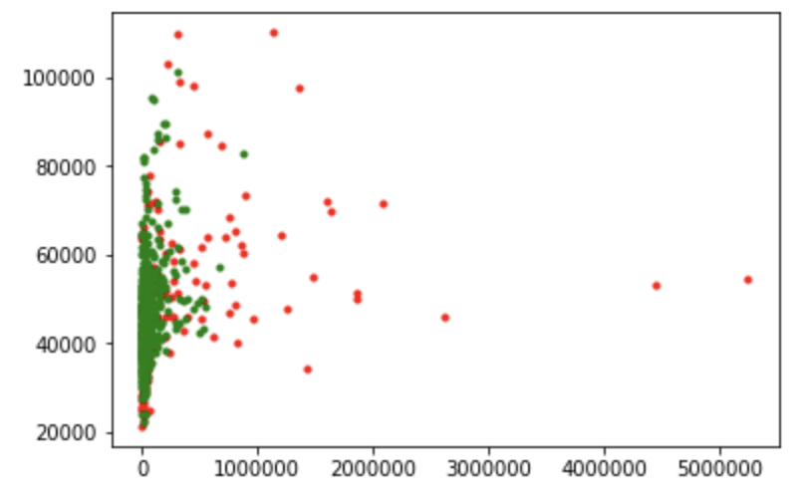
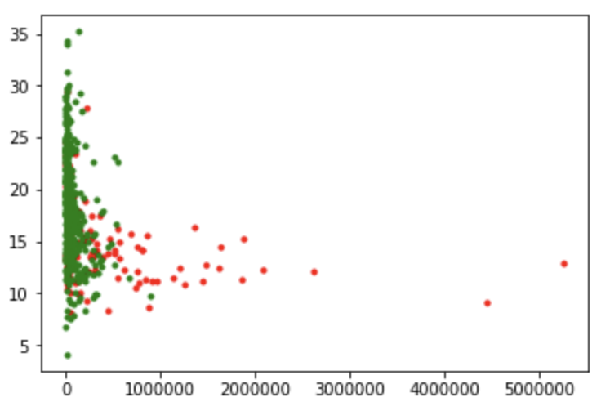

Slide 6
Future Goals
Compare data with previous elections and find out behavioral changes in features.
Use similar model with international elections and see if there’s any similarities between them
Find more behavioral patterns using more features

Slide 7
Thank you!

